Slide 1

The Structure of Crystalline Solids
Dr. J. Venkatramani
219-B
venkatramani@iiitdm.ac.in

Slide 2
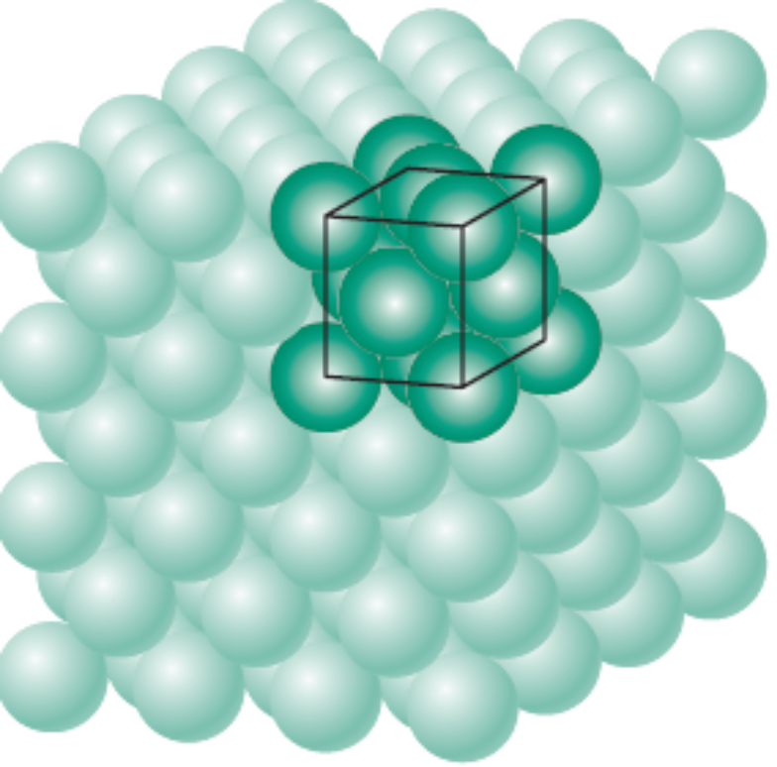
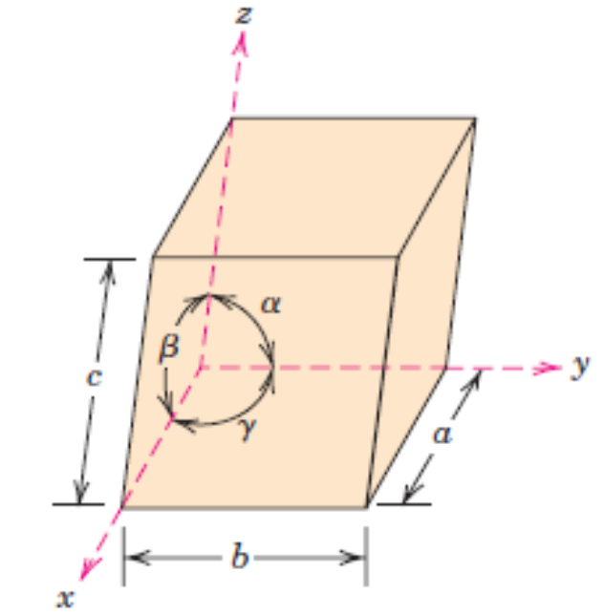
Crystalline Solid
Materials which exhibit long range regular arrangement of atoms.
The atoms are represented as ‘hard spheres’ of which the nearest ones touch each other.
Unit Cell (Crystal System) → Lattice → Atomic positions constitute a material microstructure.
What is a Unit Cell? – A repeat unit which can be translated (and rotated?) to generate a regular arrangement of atoms.

Slide 3
Lattice Types or Crystal Structures in Metals
First of all, what is a lattice?
– A pattern of points in space. Examples: Dots or Grid for making Rangoli.
A geometrical construct for the sake of understanding material microstructure.
  Face Centered (FCC)
  Body Centered (BCC)
  Hexagonal Close – Packed (HCP)

Slide 4
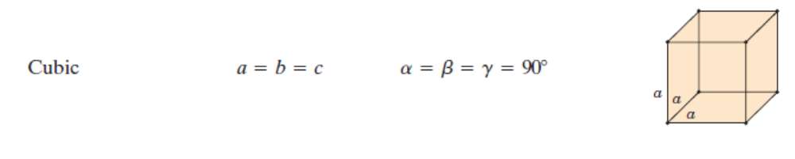
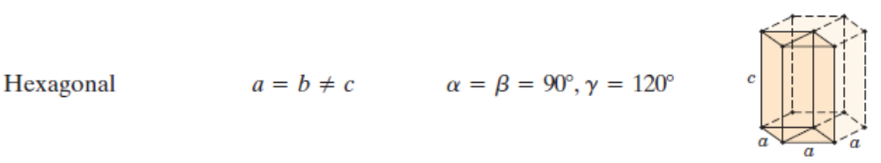
Crystal Systems – Based on Unit Cell Geometry
Based on Unit Cell Geometry there are SEVEN crystal systems.

Slide 5
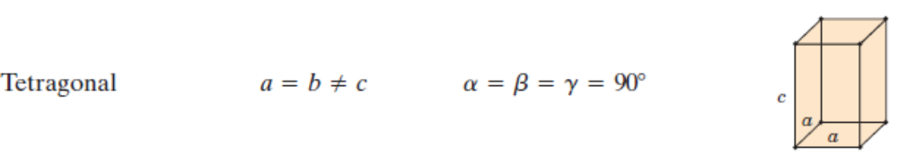
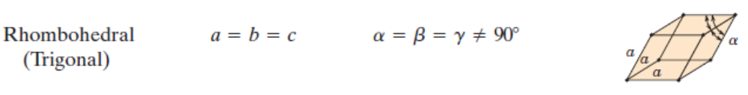
Crystal Systems – Based on Unit Cell Geometry
Based on Unit Cell Geometry there are SEVEN crystal systems.

Slide 6
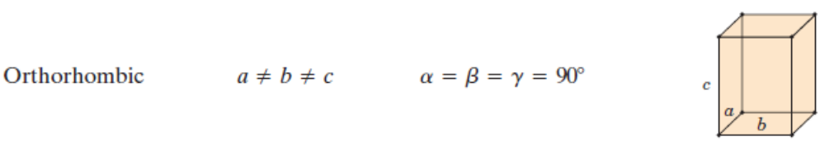
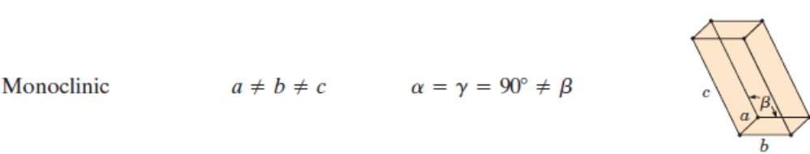
Crystal Systems – Based on Unit Cell Geometry
Based on Unit Cell Geometry there are SEVEN crystal systems.

Slide 7
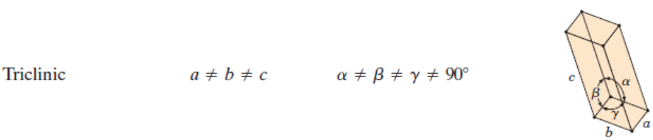
Crystal Systems – Based on Unit Cell Geometry
Based on Unit Cell Geometry there are SEVEN crystal systems.

Slide 8
Face–Centered Cubic Crystal Structure
Activity: Execute this in MATLAB and view the plot and
try doing it for other structures as well
clc
clear all
XY1 = [0 0 0;1 0 0;1 1 0;0 1 0];
XY2 = [0 0 1;1 0 1;1 1 1;0 1 1];
XZ1 = [0 0 0;0 0 1;1 0 1;1 0 0];
XZ2 = [0 1 0;0 1 1;1 1 1;1 1 0];
YZ1 = [0 0 0;0 1 0;0 1 1;0 0 1];
YZ2 = [1 0 0;1 1 0;1 1 1;0 1 1];
plot3(XY1(:,1),XY1(:,2),XY1(:,3),'b','linewidth',2,'marker','o','markersize',12)
hold on
plot3(XY2(:,1),XY2(:,2),XY2(:,3),'b','linewidth',2,'marker','o','markersize',12)
plot3(XZ1(:,1),XZ1(:,2),XZ1(:,3),'b','linewidth',2,'marker','o','markersize',12)
plot3(XZ2(:,1),XZ2(:,2),XZ2(:,3),'b','linewidth',2,'marker','o','markersize',12)
plot3(YZ1(:,1),YZ1(:,2),YZ1(:,3),'b','linewidth',2,'marker','o','markersize',12)
plot3(YZ2(:,1),YZ2(:,2),YZ2(:,3),'b','linewidth',2,'marker','o','markersize',12)
FACE = [0.5 1 0.5;0 0.5 0.5;0.5 0 0.5;1 0.5 0.5;0.5 0.5 0;0.5 0.5 1];
plot3(FACE(:,1),FACE(:,2),FACE(:,3),'r','linestyle','none','marker','o','linewidth',2,'markersize',12)
axis equal
view(-50,15)

Slide 9
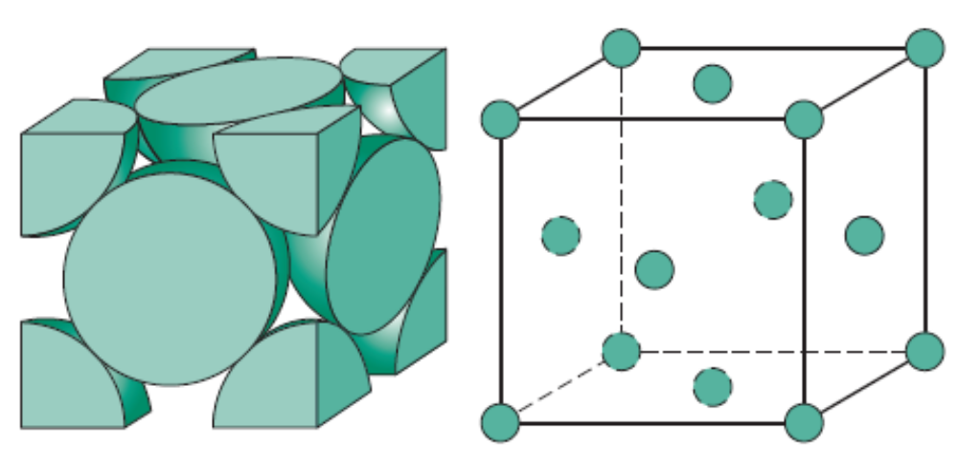
Face–Centered Cubic Crystal Structure
Co – ordination number: 12
Relation between lattice parameter and atomic radius: a = 2√2 R
Atomic Packing Factor: Ratio of volume of the atoms to volume of unit cell = 0.74
The corner atoms and face centered atoms are equivalent. One can move the lattice such that face centered become corner and the corner become face centered.

Slide 10
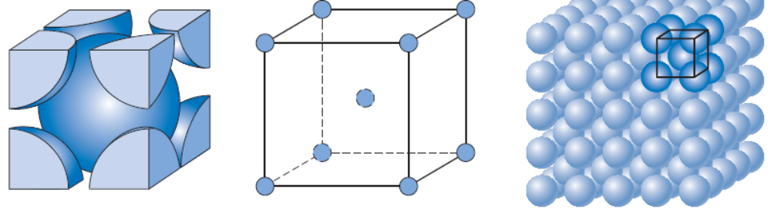
Body–Centered Cubic Crystal Structure
Co – ordination number: 8
Relation between lattice parameter and atomic radius: a = 4R/√3
Atomic Packing Factor: Ratio of volume of the atoms to volume of unit cell = 0.68
Translating the cube such that one of the corners coincide with the body centered atom will not alter the crystal structure

Slide 11
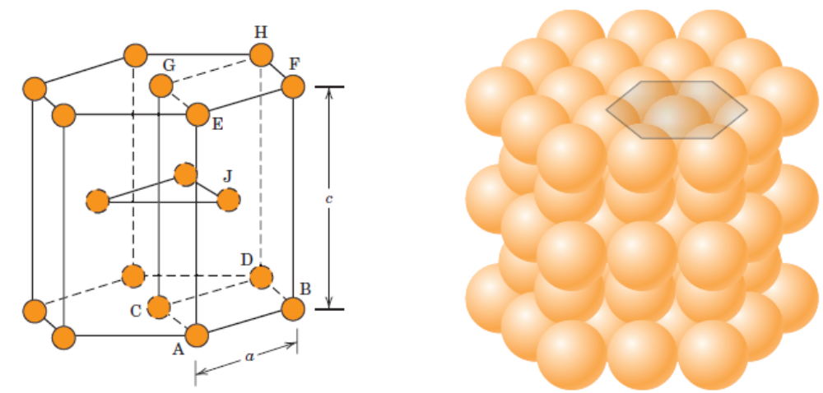
Hexagonal Close–Packed Crystal Structure
Co – ordination number: 12
Relation between lattice parameter and atomic radius: a = 2R. Additional lattice parameter c = 1.633a for closest packing
Atomic Packing Factor: Ratio of volume of the atoms to volume of unit cell = 0.74
Similar comment about translation of the hexagonal unit cell.

Slide 12
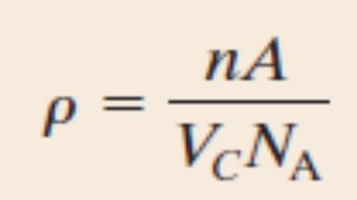
Density Computations
Example: Copper has an atomic radius of 0.128 nm, an FCC crystal structure, and an atomic weight of 63.5 g/mol. Compute its theoretical density and compare the answer with its measured density.

Slide 13
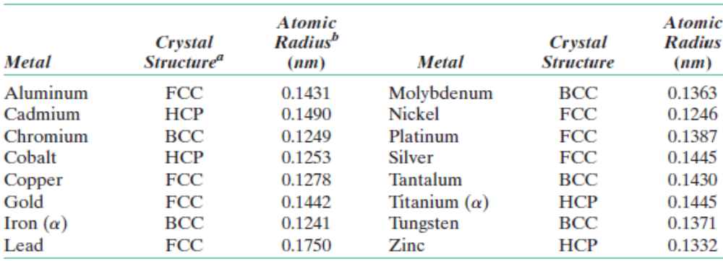
Polymorphism and Allotropy
Polymorphism refers to the existence of more than one crystal structure, commonly found in both metals and Non – metals.
Eg: Iron at room temperature has BCC crystal structure, while at a temperature of 912⁰C it forms FCC crystal structure.
Allotropy: The similar condition found in elemental solids is called Allotropy.
Examples for the three lattice types or crystal structures discussed

Slide 14
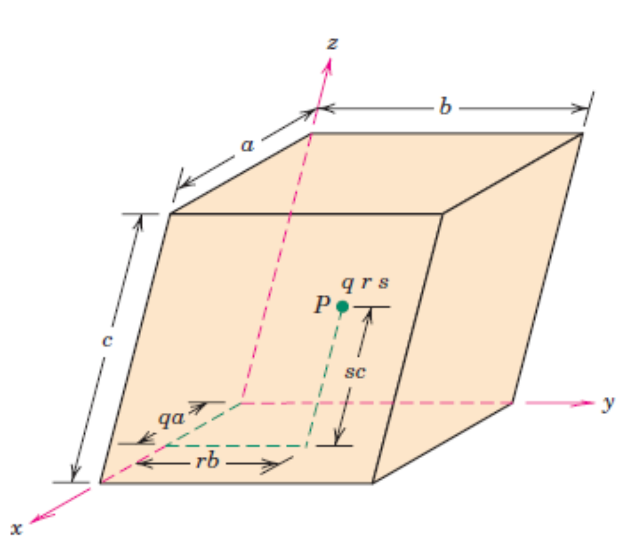
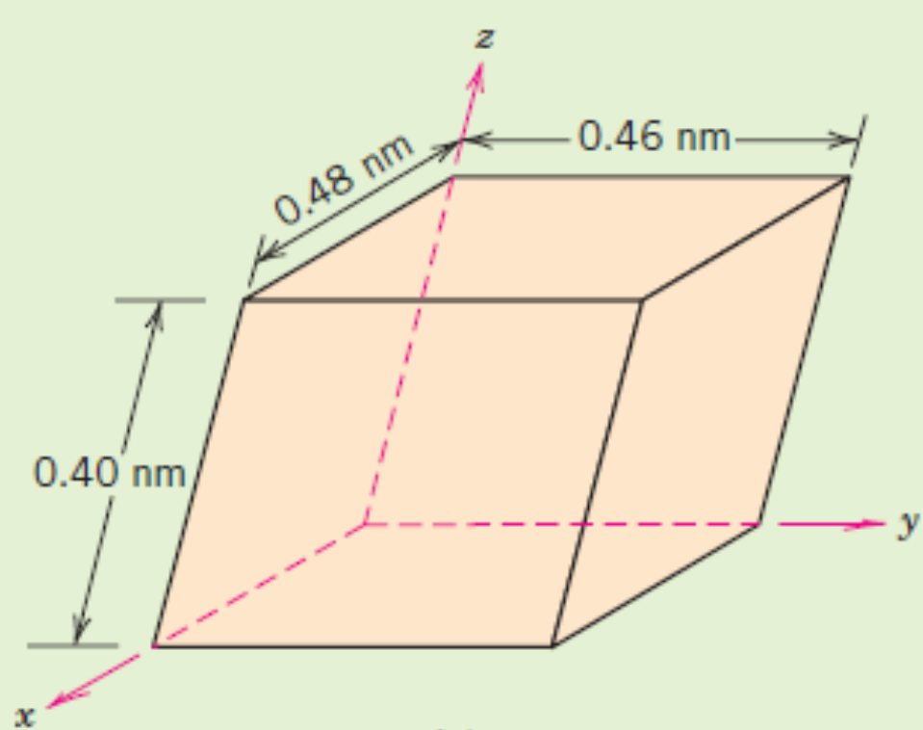
Crystallographic Points, Directions and Planes
A crystallographic point is represented using 3 co–ordinates, but as fractional multiples of unit cell lengths.
No commas or parenthesis.
Example: Locate ¼ 1 ½ in the above unit cell.

Slide 15
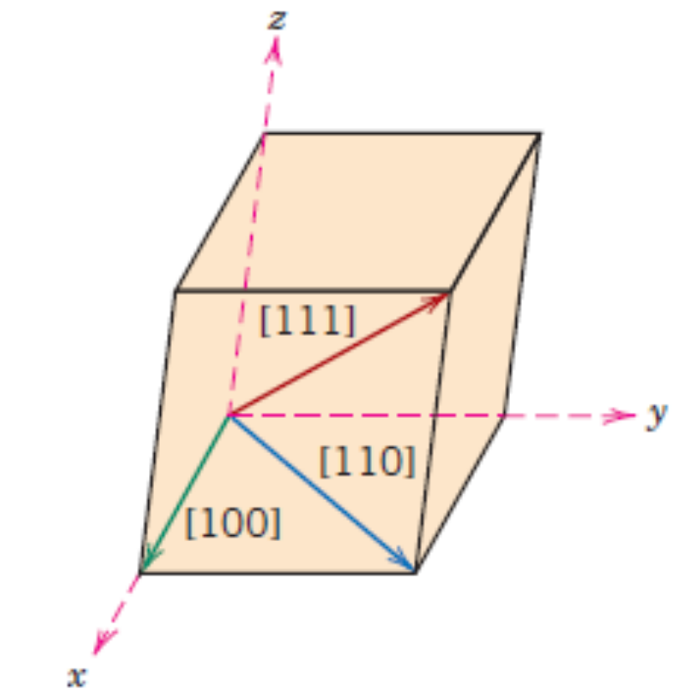
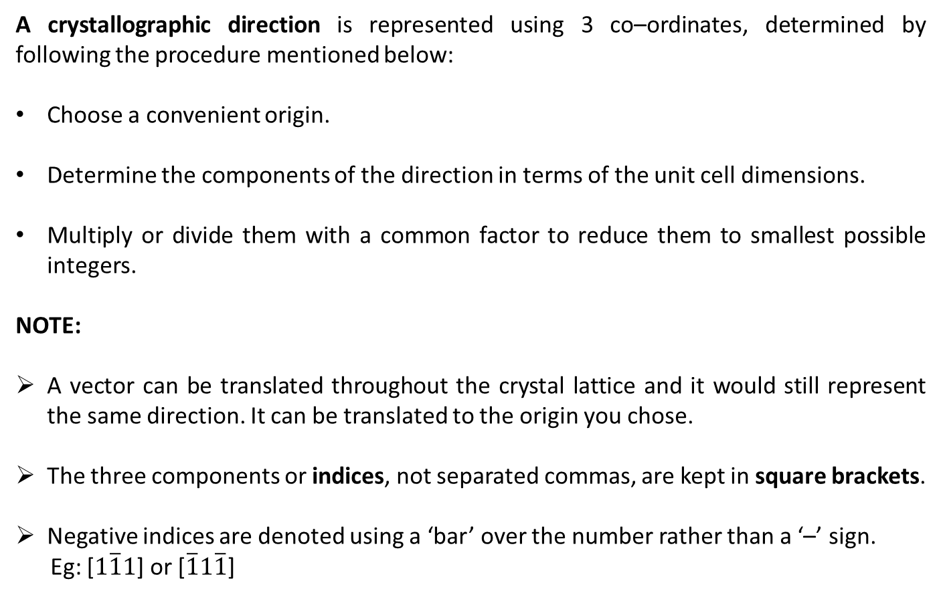
Crystallographic Points, Directions and Planes
A crystallographic direction is represented using 3 co–ordinates, determined by following the procedure mentioned below:
Choose a convenient origin.
Determine the components of the direction in terms of the unit cell dimensions.
Multiply or divide them with a common factor to reduce them to smallest possible integers.
NOTE:
A vector can be translated throughout the crystal lattice and it would still represent the same direction. It can be translated to the origin you chose.
The three components or indices, not separated commas, are kept in square brackets.
Negative indices are denoted using a ‘bar’ over the number rather than a ‘–’ sign.
Eg: [$1\overline{1}1$] or [$\overline{1}1\overline{1}$]

Slide 16
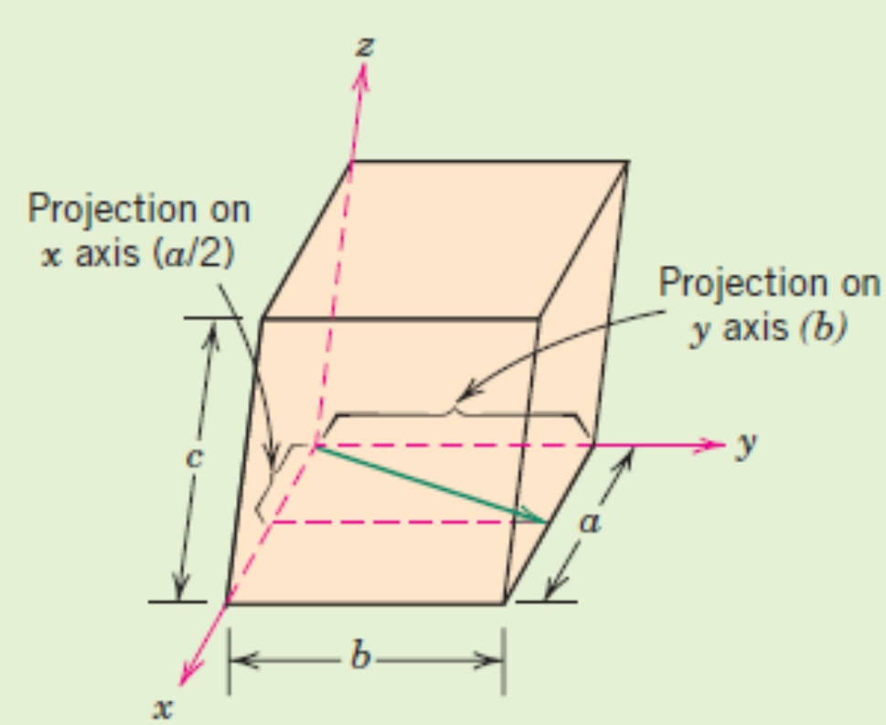
Crystallographic Points, Directions and Planes
Example 1: Determine the crystallographic direction in the figure shown.
Example 2: Draw the crystallographic direction corresponding to [1 2 1] and [2 1 1] directions.

Slide 17
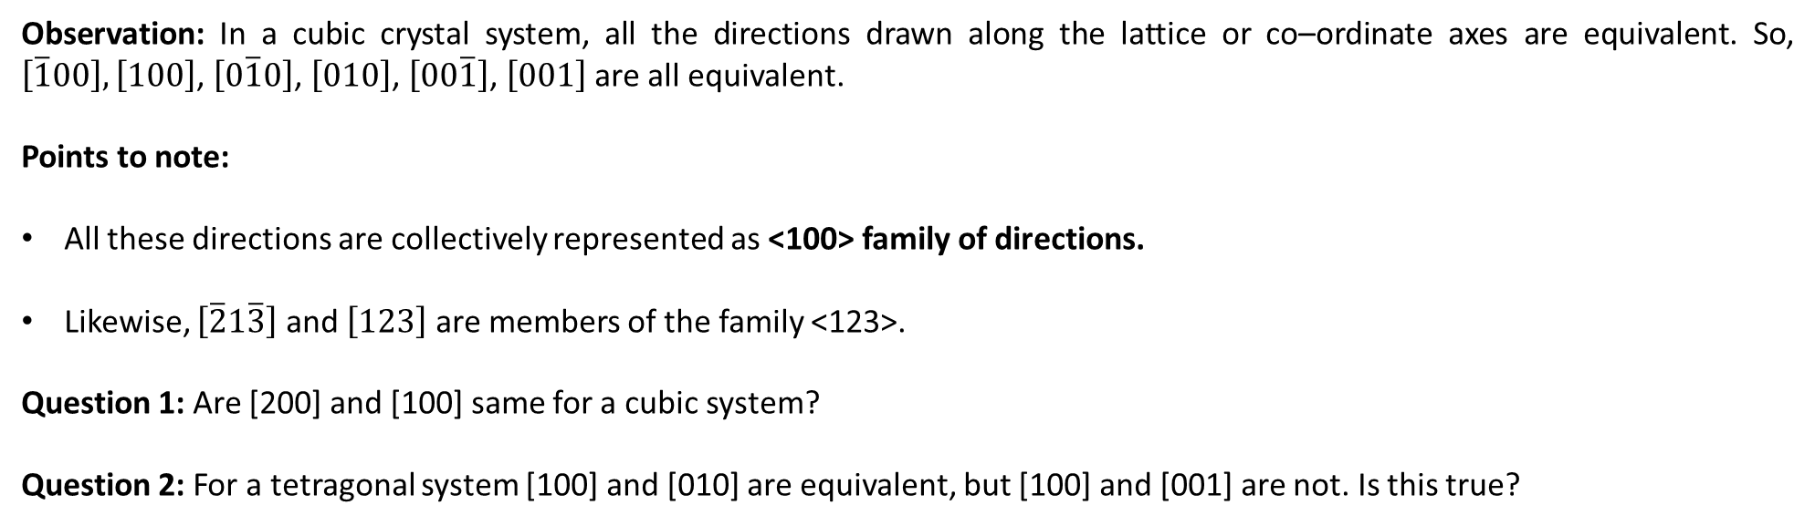
Family of Crystallographic Directions
Observation: In a cubic crystal system, all the directions drawn along the lattice or co–ordinate axes are equivalent. So, $\left[\overline{1}00\right],\left[100\right]$, $\left[0\overline{1}0\right]$, $\left[010\right]$, $\left[00\overline{1}\right]$, $\left[001\right]$ are all equivalent.
Points to note:
All these directions are collectively represented as <100> family of directions.
Likewise, $\left[\overline{2}1\overline{3}\right]$ and $\left[123\right]$ are members of the family <123>.
Question 1: Are [200] and [100] same for a cubic system?
Question 2: For a tetragonal system [100] and [010] are equivalent, but [100] and [001] are not. Is this true?

Slide 18
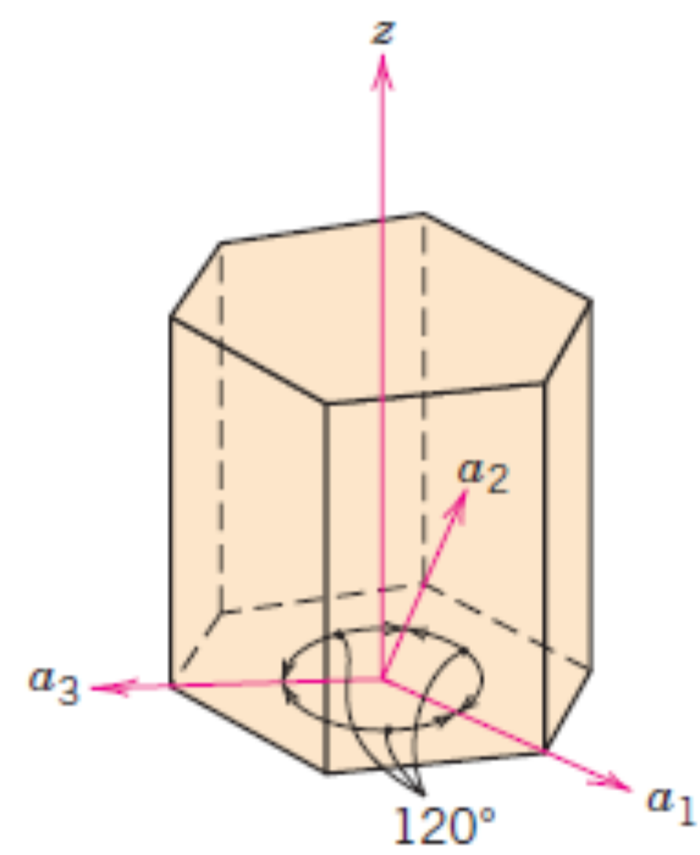
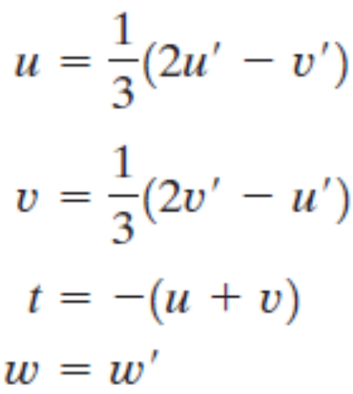
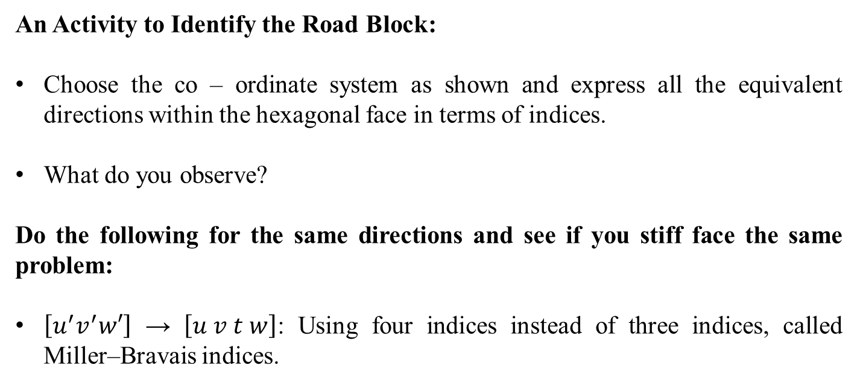
Crystallographic Directions For Hexagonal Crystals
An Activity to Identify the Road Block:
Choose the co – ordinate system as shown and express all the equivalent directions within the hexagonal face in terms of indices.
What do you observe?
Do the following for the same directions and see if you stiff face the same problem:
$\left[u^{′}v^{′}w′\right]$ → $\left[u v t w\right]$: Using four indices instead of three indices, called Miller–Bravais indices.

Slide 19
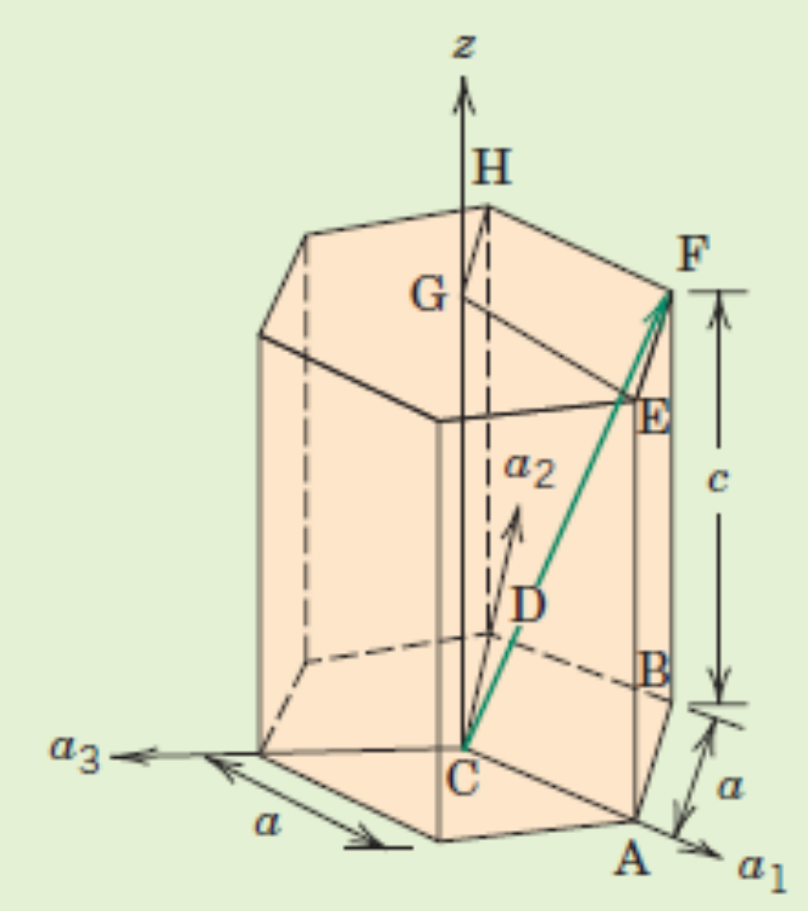
Crystallographic Directions For Hexagonal Crystals
Example: Find the indices of the directions shown

Slide 20
Crystallographic Planes
We would like to express crystallographic planes in terms of 3 indices (hkl) in a manner similar to co–ordinate geometry of planes where we use direction cosines of the normal to denote a plane. These three indices are called Miller Indices.
If the plane passes through the selected origin, either another parallel plane must be constructed within the unit cell by an appropriate translation, or a new origin must be established at the corner of another unit cell.
At this point the crystallographic plane either intersects or parallels each of the three axes; the length of the planar intercept for each axis is determined in terms of the lattice parameters a, b, and c.
The reciprocals of these numbers are taken. A plane that parallels an axis may be considered to have an infinite intercept, and, therefore, a zero index.
If necessary, these three numbers are changed to the set of smallest integers by multiplication or division by a common factor.
Finally, the integer indices, not separated by commas, are enclosed within parentheses, thus: (hkl).

Slide 21
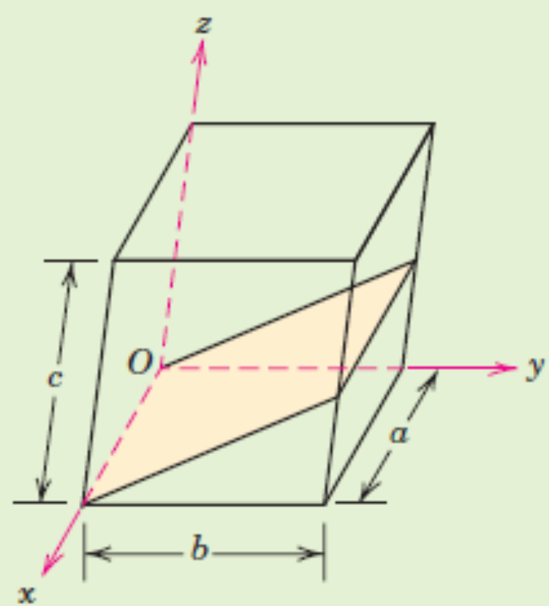
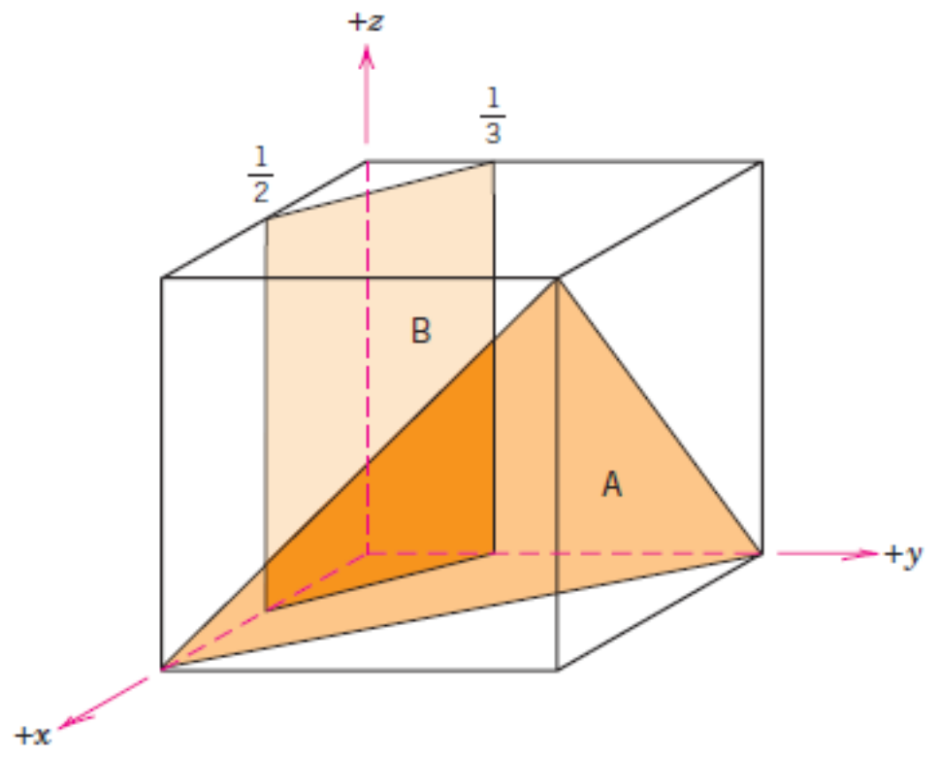
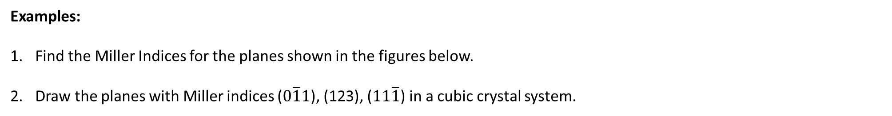
Crystallographic Planes
Examples:
Find the Miller Indices for the planes shown in the figures below.
Draw the planes with Miller indices ($0\overline{1}1$), (123), ($11\overline{1}$) in a cubic crystal system.

Slide 22
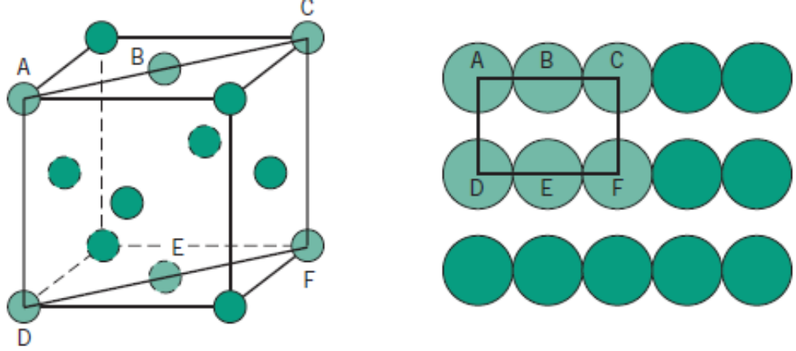
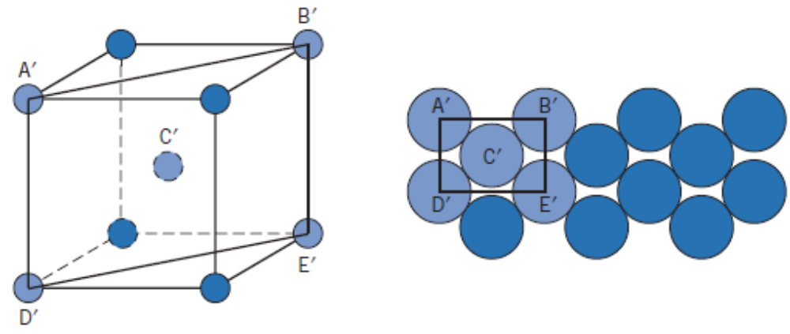
Atomic Arrangement and Equivalence of planes
In FCC
In BCC

Slide 23
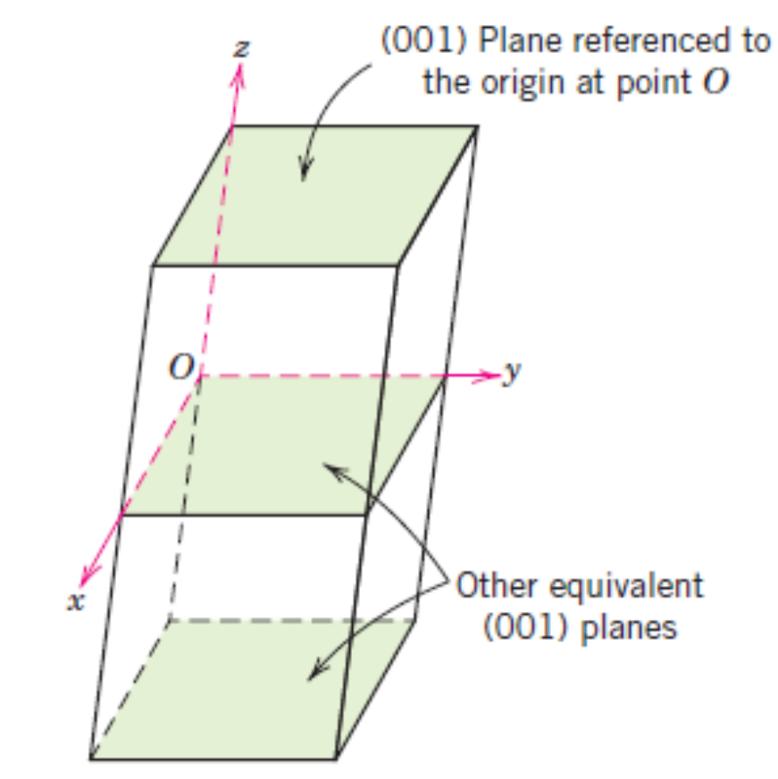
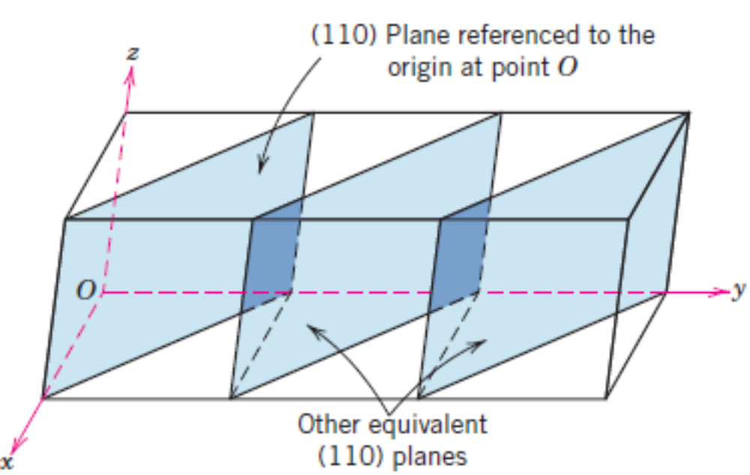
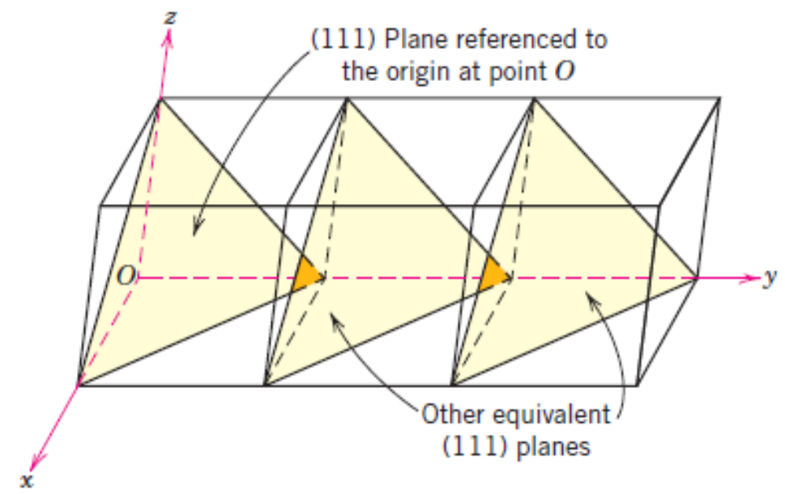
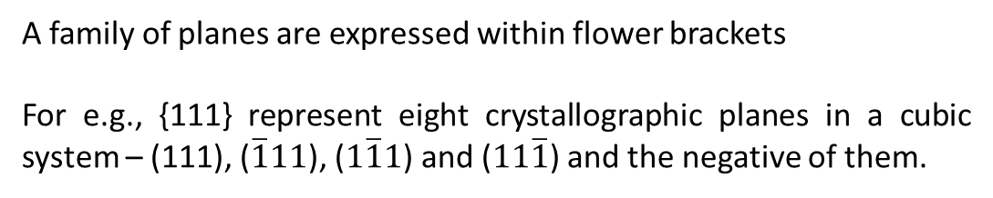
Crystallographic Planes – Equivalent planes
A family of planes are expressed within flower brackets
For e.g., {111} represent eight crystallographic planes in a cubic system – (111), ($\overline{1}11$), ($1\overline{1}1$) and ($11\overline{1}$) and the negative of them.

Slide 24
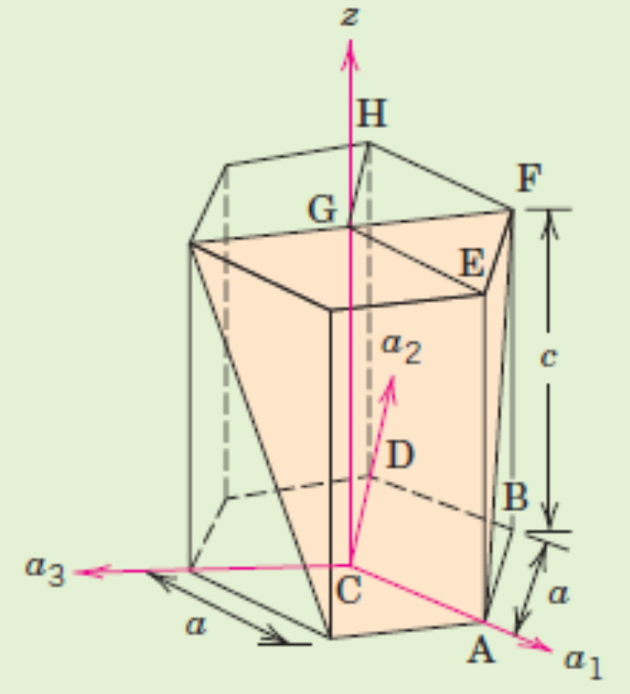
Crystallographic Planes – Hexagonal Crystals
Even while representing planes, we need to introduce an additional, dependent co–ordinate in order that a family of planes contain the same combination of indices.
The indices h k and l are determined first in the same manner as for cubic systems. After this, an additional co – ordinate i is defined as i = –(h + k). The four – index representation for crystallographic planes in Hexagonal systems is (hkil).
E.g., Find the Miller indices of the crystallographic plane shown here.

Slide 25
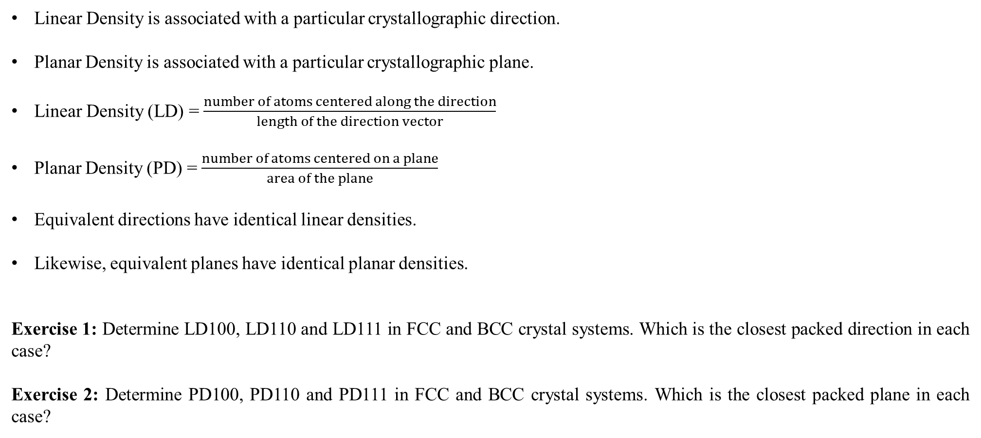
Linear and Planar Densities
Linear Density is associated with a particular crystallographic direction.
Planar Density is associated with a particular crystallographic plane.
Linear Density (LD) = $\frac{number of atoms centered along the direction}{length of the direction vector}$
Planar Density (PD) = $\frac{number of atoms centered on a plane}{area of the plane}$
Equivalent directions have identical linear densities.
Likewise, equivalent planes have identical planar densities.
Exercise 1: Determine LD100, LD110 and LD111 in FCC and BCC crystal systems. Which is the closest packed direction in each case?
Exercise 2: Determine PD100, PD110 and PD111 in FCC and BCC crystal systems. Which is the closest packed plane in each case?

Slide 26
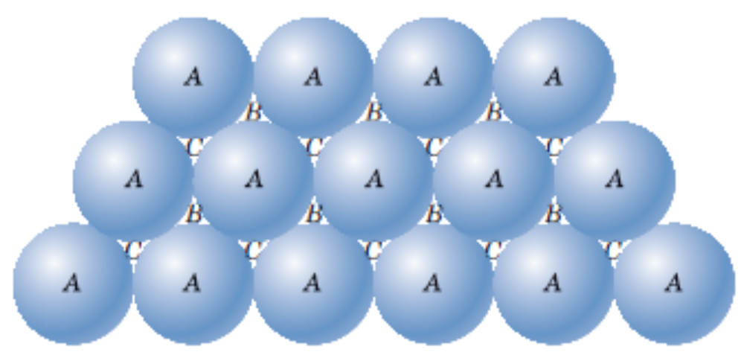
Close – packed Crystal Structures
FCC and HCP are the closest packed, with an Atomic Packing Factor value = 0.74.
In addition to unit cell representation, these two crystal structures can be visualized as stacking of close – packed planes in a certain pattern.
Then, the stacking sequence decides the type of crystal structure.
Can you realize HCP Crystal Structure from this picture? What kind of stacking sequence should we follow hereafter?

Slide 27
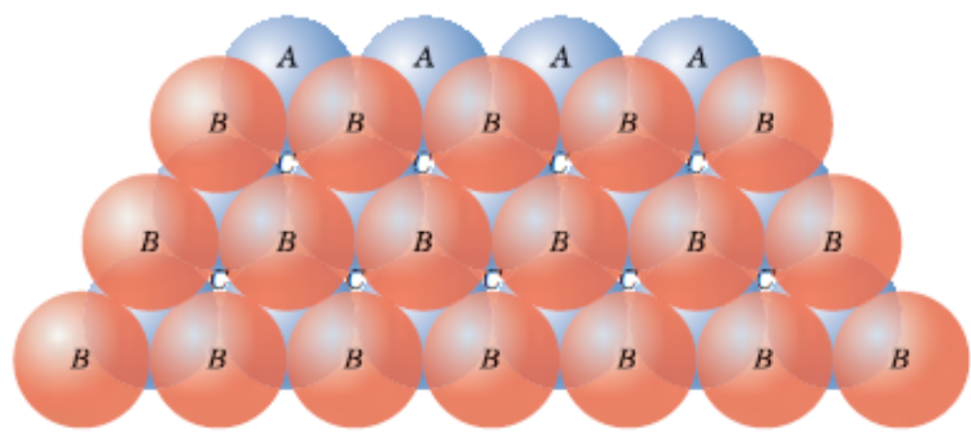
Close – packed Crystal Structures
FCC and HCP are the closest packed, with an Atomic Packing Factor value = 0.74.
In addition to unit cell representation, these two crystal structures can be visualized as stacking of close – packed planes in a certain pattern.
Then, the stacking sequence decides the type of crystal structure.
One can occupy either B or C positions as shown in the picture on the right (pink ‘B’ spheres placed over blue ‘A’ spheres). So, if we occupy B positions, the next layer of atoms can occupy either C or A positions. If we choose A positions, we will get HCP. If we choose C positions we will get FCC.
Therefore, FCC corresponds to ABCABCABC….stacking sequence.
HCP corresponds to ABABAB…..stacking sequence.

Slide 28
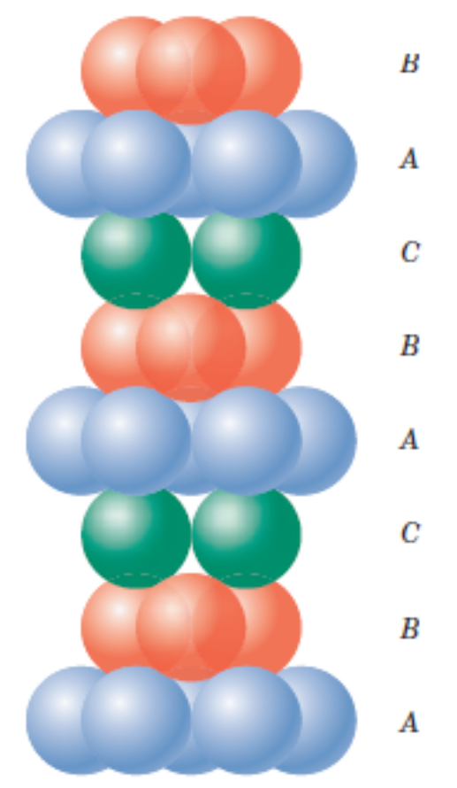
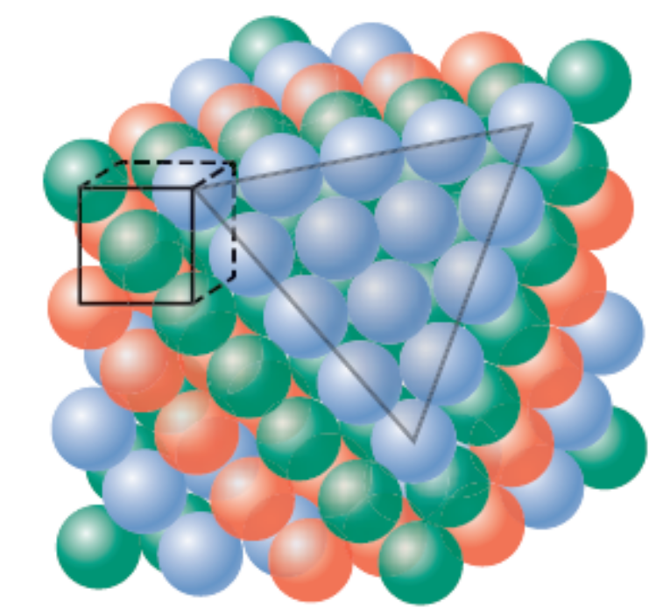
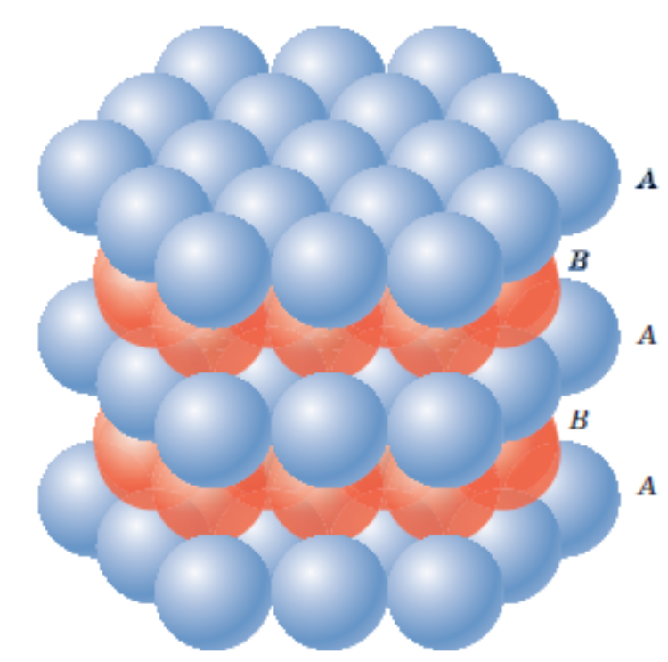
Close – packed Crystal Structures
FCC corresponds to ABCABCABC….stacking sequence. These planes are {111} family.
HCP corresponds to ABABAB…..stacking sequence. These planes are {0001} family.

Slide 29
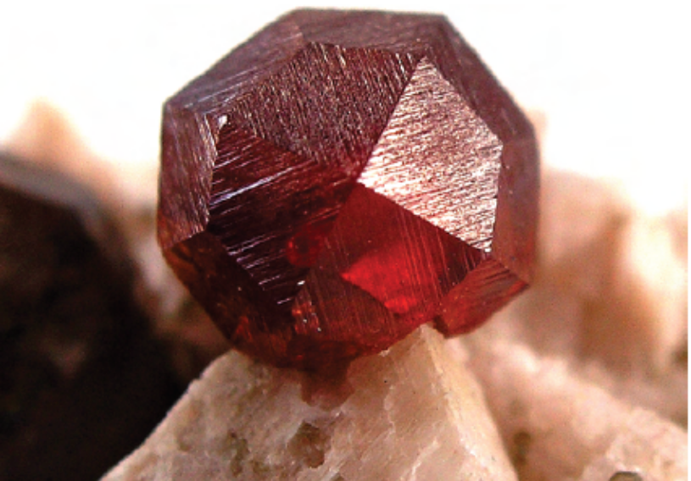
Crystalline and Non – Crystalline Solids
Single Crystal:
If the regular atomic arrangement spans through the entirety of the specimen, it is a single crystal material.
There are several naturally available single crystal materials such as the one shown here. It is a garnet single crystal – stone containing silicate mineral.
Apart from the naturally available materials, artificially one can grow single crystals by maintaining stringent ambient conditions.
Single crystal materials have applications in electronic microcircuits and other semiconductors.
What are the practical difficulties that you expect in growing a single crystal?

Slide 30
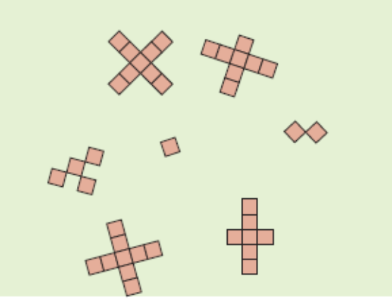
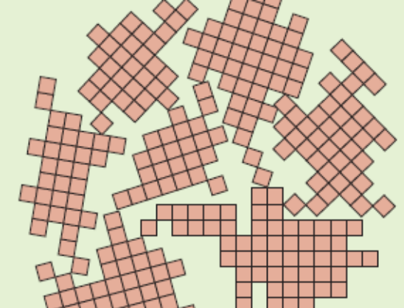
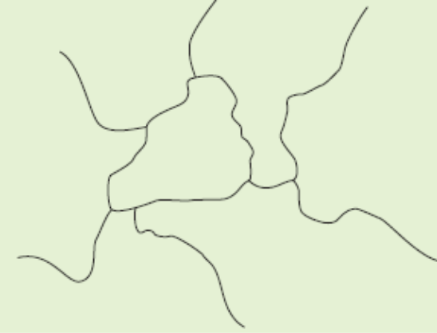
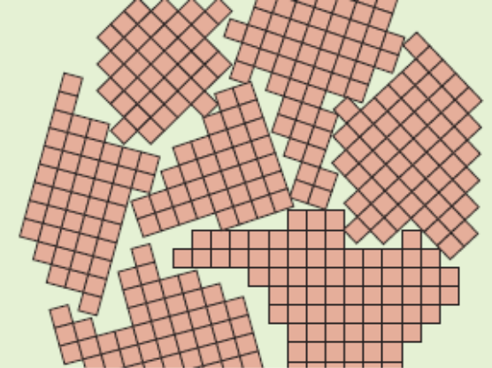
Crystalline and Non – Crystalline Solids
Poly–crystalline Material:

Slide 31
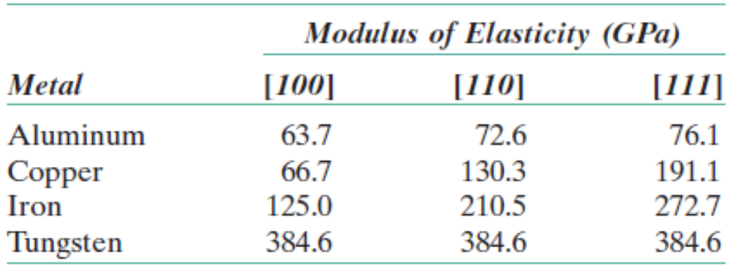
Crystalline and Non–Crystalline Solids
Anisotropy:
Directional dependency of a property is called Anisotropy.
A material which is magnetically anisotropic need NOT have mechanical anisotropy.
When there is no directional dependence of a property, then we call the material to be isotropic.
A polycrystalline material can be isotropic if there are a large number of crystals or grains, each with random orientation. Thus, although an individual grain may be anisotropic, a collection of such grains with random orientations can behave isotropic.

Slide 32
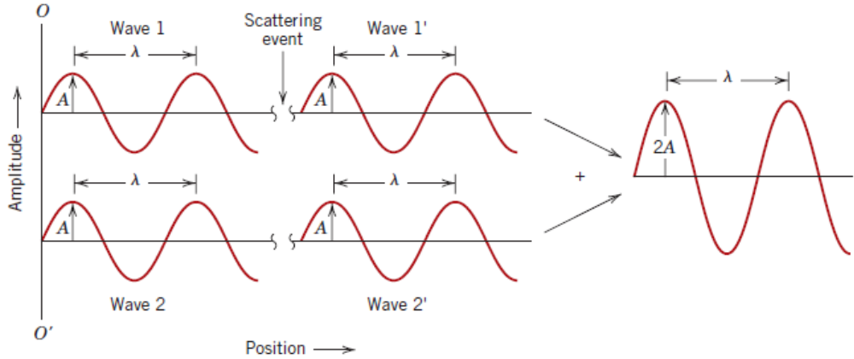
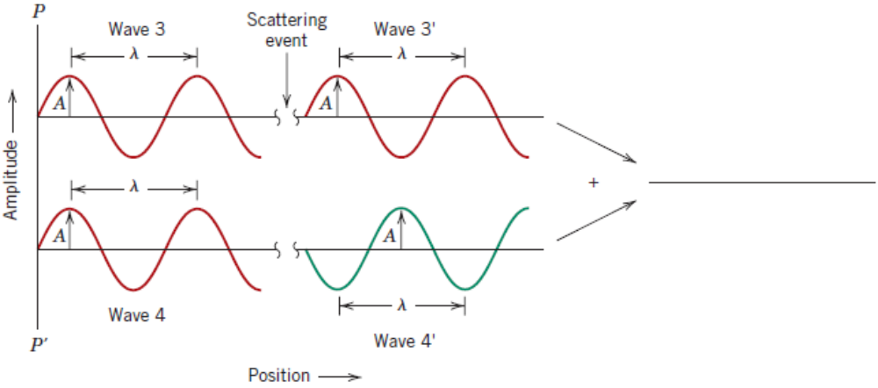
Determination of Crystal Structures Using X–Ray Diffraction
Diffraction:

Slide 33
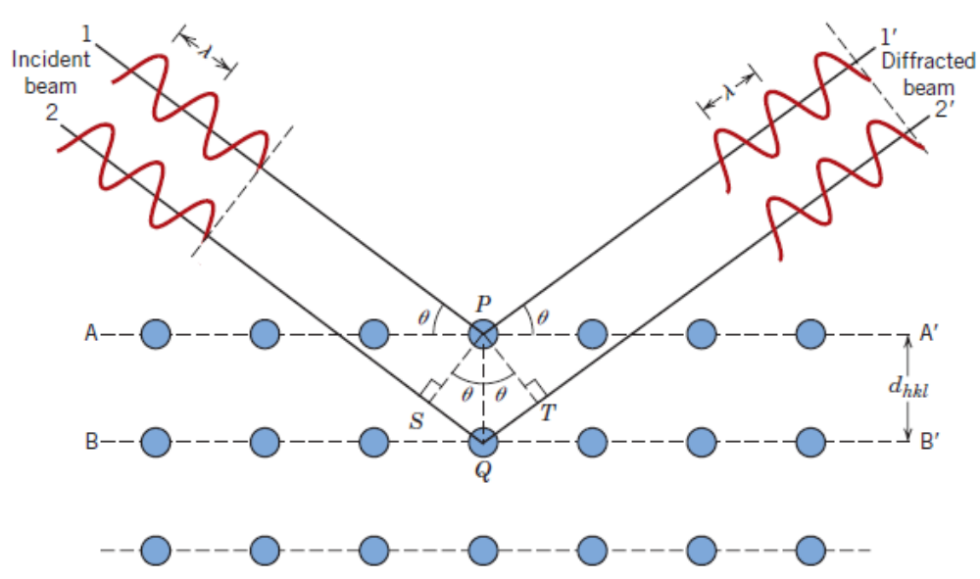
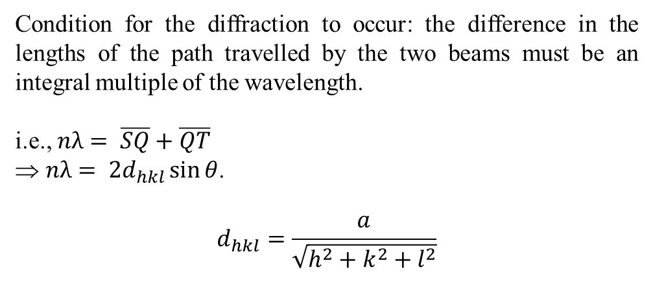
Determination of Crystal Structures Using X–Ray Diffraction
Diffraction:
Condition for the diffraction to occur: the difference in the lengths of the path travelled by the two beams must be an integral multiple of the wavelength.
i.e., $nλ= \overline{SQ}+\overline{QT}$
$nλ= {2d}_{hkl}\sin{θ}$.
$$d_{hkl}=\frac{a}{\sqrt{h^{2}+k^{2}+l^{2}}}$$
The above condition is necessary, but not sufficient.
For BCC, h + k + l must be even.
For FCC, h, k, l all must be either odd or even.

Slide 34


Determination of Crystal Structures Using X–Ray Diffraction
Schematic of Setup
A typical plot of Intensity Vs Diffraction Angle

